Slide 1

Comparing WinGet and Chocolatey
A Real-World Look at Package Management Tools
Paul Broadwith

Slide 2

Many thanks to our sponsors:

Slide 3




Paul Broadwith
Technical Engineering Manager, Chocolatey Software Inc.
Glasgow, Scotland
Over 30 years IT experience in many different sectors

Slide 4


Slide 5
Personal opinion.
Not sponsored by Chocolatey Software.
Research & findings based.
Unbiased?
No scores.

Slide 6
Q&A
15 minutes

Slide 7
What This Talk Isn’t
winget list –q adobe.acrobat.reader
winget install --id adobe.acrobat.reader.64-bit
winget list
winget uninstall –-id adobe.acrobat.reader.64-bit
choco search adobereader
choco install adobereader
choco list
choco uninstall adobereader
Notes:
No demos.

Slide 8
What This Talk Is
Supported and unsupported platforms.
Installation options.
Integration and third-party support.
Packages, manifests, submissions and community.
Organizational options.
Privacy.
Summary.

Slide 9
Comparison Overview
Used Windows 10 and 11 Pro 22H2 (patched to May 2023).
Latest WinGet (1.4.1) and Chocolatey CLI (2.0.0).
"Chocolatey" means "Chocolatey Products"
Comparisons made between April and June 2023.

Slide 10

Supported and Unsupported Platforms
And a bit of “what it runs on”, thrown in for good measure.
Image courtesy of https://www.pexels.com/photo/close-up-of-a-keyboard-4567339/

Slide 11



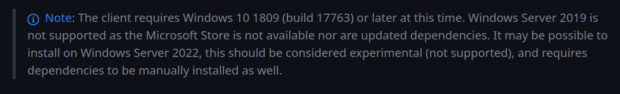

Supported Operating Systems
Windows 11 22H2 / 22H1
Windows 10 22H2 / 22H1
Windows Server 2022
Windows Server 2019
Windows Server 2016
Windows Server 2012 R2
Windows Server 2012
Windows Server 2008R2 in Azure
WinGet

Slide 12






Working Operating Systems
Windows 10 >= 1809
Windows 10 < 1809
Windows 8.1
Windows 8
Windows 7
Windows Server 2008
Windows Server 2003 / 2003 R2

Slide 13

Installation
The subtle art of getting up and running.

Slide 14

Supported WinGet Install
Microsoft Store (App Installer)
From GitHub
Windows Patch?
(Chocolatey package)
Microsoft Store (App Installer)
From GitHub.
OOB (sort of).
(Chocolatey package)

Slide 15
Supported Chocolatey CLI Install
Install script from chocolatey.org/install.ps1
MSI
(WinGet)
Install script from chocolatey.org/install.ps1
MSI
(WinGet)

Slide 16

Integrations & Support
What does it work with. What works with it.
Image courtesy of https://www.tumblr.com/stra-tek
Notes:
10

Slide 17
All About The PowerShell
PowerShell Gallery module: Microsoft.WinGet.Client (0.2.1)
Chocolatey CLI package: winget.powershell
PackageManagement / AnyPackage provider.
Cobalt – Crescendo wrapper (github.com/ethanbergstrom/Cobalt)
Notes:
Deployment may be easier but only comes with Windows 11 out of the box. But can also be installed via Chocolatey which I’d argue is the least painful way of doing it. Getting WinGet onto a computer isn’t rocket science, but it’s not what I’d call easy.
Some organizations like the ‘do anything you want with it’. MIT license.
The tool has the Microsoft Store source that needs to be removed if you don’t want prompted to accept the terms of using it. Documentation uses Azure as the deployment area.
I can’t see how you could make the manifests internal unless you rewrote them each time. They would then be stored separately from the binary files which may be desirable but isn’t a single transportable unit.
There is no repository manager support outside of the winget.pro and the WinGet CLI REST Source which requires Azure.
If you need support, help with issues, training etc. then you are on your own. There is no support with the tool. SLA’s or prioritisation with issues

Slide 18
All About The PowerShell
Machine readable output.
Official Community PowerShell modules.
cChoco and Chocolatey PowerShell DSC Resources.
PackageManagement / AnyPackage provider.
It’s built on PowerShell!
Foil – Crescendo wrapper (github.com/ethanbergstrom/Foil)
Notes:
Chocolatey PowerShell modules in the official Chocolatey Community.
PackageManagement is now AnyPackage.

Slide 19
Supported Sources
Microsoft Store.
Azure REST Source (github.com/microsoft/winget-cli-restsource)
Static web source.
File Share.
Local Folder.
NuGet v2 (OData).
NuGet v3 (JSON).
Static NuGet v3 source.
Alternative sources – WinGet coming soon.
File Share.
Local Folder.
Notes:
WinGet needs a REST API to query.
WinGet allows you to specify a folder of manifests but only for the same software.
Mixing software manifests in the same folder causes a unhelpful error.
Doesn’t support UNC paths - https://github.com/microsoft/winget-cli/issues/160
You cannot setup a local folder as a manifest source for multiple packages.
A local folder can be a repository, but you must set it up as a repository (with the format, .msix file etc.). This wasn’t a supported option but something that was suggested by a community user.

Slide 20


















Configuration & Repository Managers
Nuget.org
PowerShell DSC
GitHub Packages
Artifacts
AnyPackage
Package Registry
Notes:
* This is for native integrations.
CFEngine is a popular one listed a lot but it doesn’t have official support for either so no point listing it. It does have community written Chocolatey integrations but they are ad-hoc scripts here and there.
SCCM doesn’t have native integration but it’s worth talking about. You can use both WinGet and Chocolatey CLI commands from that.
WinGet doesn’t appear to have an official DSC resource that can be used - https://github.com/microsoft/winget-cli/issues/2697
Ansible cannot have a WinGet playbook as they test on Windows Server versions which WinGet does not support - https://github.com/ansible-collections/community.windows/issues/89#issuecomment-1266054035. It also doesn’t run under WinRM.
There is a new Puppet module for called `wingetpkg` (https://forge.puppet.com/modules/voss2000/wingetpkg/1.2.1/readme). It’s only a week old.
Chef. There is a community recipe that allows installation but looks like it has been abandoned - https://github.com/thumperward/winget_package
Octopus Deploy. Very strange that WinGet isn’t a supported template.
SaltStack. As WinGet doesn’t support Windows Server operating systems, support is not being added at this time.
This is a list of repository managers that support multiple repository types.
Artifactory – doesn’t support WinGet feeds (https://jfrog.atlassian.net/browse/RTFACT-22211)
MyGet – can’t find anything on that.
Nexus – can’t find anything on that.
GitHub Packages – can’t find anything on that for WinGet - https://docs.github.com/en/packages/learn-github-packages/introduction-to-github-packages
ProGet – doesn’t support it - https://forums.inedo.com/topic/3257/support-for-winget-feed/10
Azure Artifacts – only supports NuGet, npm, and Maven packages - https://azuredevopslabs.com/labs/azuredevops/packagemanagement/
Cloudsmith – doesn’t support it yet - https://help.cloudsmith.io/docs/supported-formats
Feedz.io – doesn’t support it - https://feedz.io/features
Nuget.org – cannot find anything but as it’s a NuGet repository, I assume it doesn’t support it.
GitLab Package Registry – not supported - https://gitlab.com/gitlab-org/gitlab/-/issues/346882
There is also winget.pro but it doesn’t support multiple repository types so wasn’t included here.

Slide 21

Packages and Manifests
And submitting those packages and manifests. And stuff about where they are submitted to.
Notes:
15

Slide 22
Manifests
Use separate wingetcreate tool.
Find defaults from MSI.
Simple, question–based approach.
Creates multiple YAML files.
No flexibility in manifest format.
Only runs installers or adds supported formats.
Can submit from the tool.

Slide 23
Packages
Use choco new command.
Finds defaults from most installers.
XML format.
Use push command to ‘submit’.
Uses PowerShell to give flexibility (package parameters etc.).
Package Builder UI with Business edition.

Slide 24
WinGet Community Repo.
Steps unclear: validation, installation and scanning.
AV is Defender and ‘other’ scanners.
Installers that are not silent cannot be added.
False positive AV scans not accepted.
Interaction via Pull Request comments.
WinGet Team and Community Moderators.
4200 packages and 28,000 versions.
Notes:
IUnsure of putting ‘Community’ in quotes as I see it only being called the ‘winget source’. But it looks to be maintained by the community.
There are 10 WinGet Team and 9 Community Moderators.

Slide 25
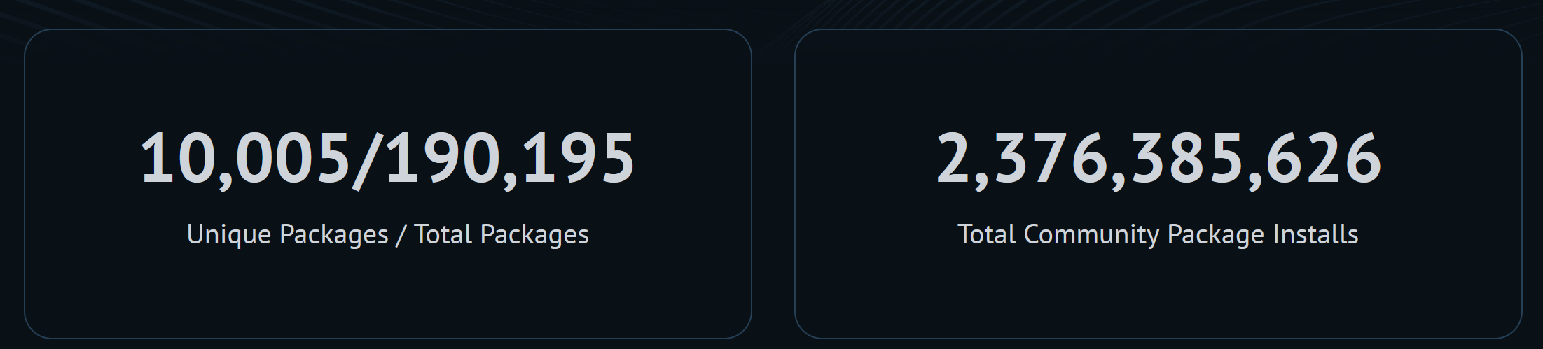
Chocolatey Community Repo.
Not silent installers can be scripted, are accepted.
Work with maintainers on AV false positives and package issues.
Interaction via Moderation comments.
Chocolatey Team and Community Moderators.
Notes:
Moderators: Chocolatey Team 6 and 6 Community Moderators.

Slide 26

Organizational Options
Different needs for different use cases.
Notes:
20

Slide 27
Organizations & Support
Deployment may be easy.
Open-source license important for some orgs.
Tied to Microsoft and Azure.
No / limited internal support – manifest & binary location.
Limited repository manager options.
No source authentication?
Free. No business support.
Notes:
Deployment may be easier but only comes with Windows 11 out of the box. But can also be installed via Chocolatey which I’d argue is the least painful way of doing it. Getting WinGet onto a computer isn’t rocket science, but it’s not what I’d call easy.
Some organizations like the ‘do anything you want with it. MIT license.
The tool has the Microsoft Store source that needs to be removed if you don’t want prompted to accept the terms of using it. Documentation uses Azure as the deployment area.
I can’t see how you could make the manifests internal unless you rewrote them each time. They would then be stored separately from the binary files which may be desirable but isn’t a single transportable unit.
There is no repository manager support outside of the winget.pro and the WinGet CLI REST Source which requires Azure.
If you need support, help with issues, training etc. then you are on your own. There is no support with the tool. SLA’s or prioritisation with issues

Slide 28
Organizations & Support
Deployment is easy.
Open-source license important for some orgs.
Flexible and decentralized.
Integrates with everything.
Internal package support.
NuGet v2 and v3 repository managers.
Free and business options.
Notes:
Deployment is via code, MSI or WinGet.
While there is a licensed edition of Chocolatey CLI, many organisations use the free and open-source version. The free Apache 2 license is important for them.
Chocolatey products are not written to be tied to any one product, cloud solution, repository manager, integrations etc. It’s philosophy is top be a tool you can use in your current workflow.
You can have a completely internal setup for Chocolatey and many companies do. It’s quoted that the packages that are on the Chocolatey Community Repository are a fraction of those made available internally.
Business support includes a Support Team, Product Lifecycle, SLA’s and a median wait time of 12 minutes (June 2023). That was a plug. I admit it.

Slide 29

Privacy
The world of being watched in everything you do.
"security-cameras-4031" by Jaymis is licensed under CC BY 2.0.
Notes:
25

Slide 30
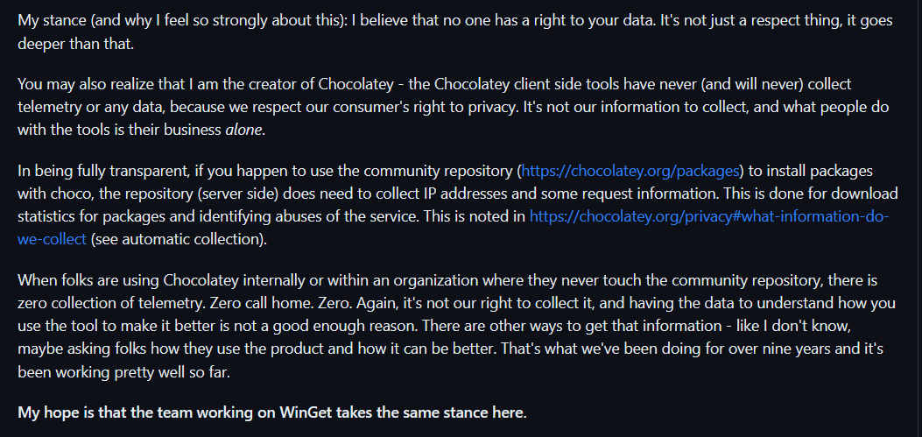



Telemetry
Collects data by default.
Opt-out.
Honours Windows privacy settings.
Dependent package collects data with no opt-out.
No telemetry.
https://github.com/microsoft/winget-cli/issues/179
Notes:
Private WinGet builds do not have telemetry enabled.
Windows 10 set to Required data means WinGet will not send data back.
Dependent package ‘Microsoft.Ui.Xaml collects telemetry data with no way to opt-out (that I could find).

Slide 31
Summary
Easy Installation.
Early - 3 years old.
Large repository.
Simple.
Nice terminal integration.
Manifest is limiting.
Microsoft / Azure centric.
Docs need work.
Easy installation.
Mature - 12 years old.
Largest Windows repository.
Powerful. Can be complex.
Metadata & PowerShell are a blessing & curse.
Flexible and decentralized.
Docs need work.

Slide 32

What to Choose?
Photo by form https://pxhere.com/en/photo/704019

Slide 33



blog.pauby.com
@pauby@mastodon.social
github.com/pauby
pau.by/talks
pau.by/linkedin

